Slide 1

Data Management Ethical Theory and Frameworks
Dr Emma Murphy
Week 2/3, January 2026

Slide 2
Data Ethics
Ethics = the study of human well-being
Data ethics = the study of how data affects human well-being (positive and negative)
(Coloner, 2019)
https://www.linkedin.com/learning/ethics-and-law-in-data-analytics/ethical-foundations-part-3?u=56744273

Slide 3
Data Ethics
Data Impacts People – while certain data is highly personal or sensitive it is hard to think of examples of ANY data that does not impact people in some way.

Slide 4
Ethics
﻿Ethics is concerned with describing or defining the ‘good’ and understanding how do we decide what is ‘good’.
(O'Keefe and O’Brien, 2018)

Slide 5
Ethical Theory
Questions we might want an ethical theory to answer for us:
Which acts are right and which are wrong? Which acts “ought”(morally) we to perform
Who is part of our moral community? Towards whom (or what) do we have moral duties and obligations? (Some/all other humans? Animals? Ecological systems? Androids/computers?)
How do moral ‘oughts’ interact with other reasons for action? Do they always “trump” other reasons?

Slide 6
Ethical Theory
What makes a particular action right or wrong?
What is it about the action that determines its moral status?
How do we know what is right and wrong?
What, if anything, motivates us to do what is right?
Sources:
Haslanger, S. (2012). 24.03 Good Food: The Ethics and Politics of Food Choices, Fall 2012.

Slide 7
Normative Ethics
Normative ethics seeks to set norms or standards for conduct about what one ought to do, questions about what morality requires/permits us to do, and what is morally valuable and it has been a central part of Western ethics since ancient times.

Slide 8
Deontological ethics
The word deontological is derived from the Greek word deon, meaning ‘duty’. It is concerned with right action – in other words, with doing the right thing simply because it is the right thing to do. Deontological theories focus on whether ethical decisions per se are right or wrong, regardless of the consequences or intentions of those ethical decisions. (SOAS, 2015).

Slide 9
Deontological ethics
This reasoning is founded on the desirability of principle (usually duties or rights) to act in a given
situation. The two main non-consequentialist theories are ethics of duties and ethics of rights and justice. Both of these are rooted in assumptions about universal rights and wrongs and responsibilities.
(SOAS, 2015)

Slide 10
Deontological ethics
This means that people who promote these types of ethical principles usually believe that they should be applied to everyone, everywhere in the world. If a child in one country has a right to an education, then this means that all children, everyone in the world, should have a right to an education
(SOAS, 2015)

Slide 11
The Universal Declaration of Human Rights
Article 2: The Universal Declaration of Human Rights ‘Everyone is entitled to all the rights and freedoms set forth in this Declaration, without distinction of any kind, such as race, colour, sex, language, religion, political or other opinion, national or social origin, property, birth or other status. Furthermore, no distinction shall be made on the basis of the political, jurisdictional or international status of the country or territory to which a person belongs, whether it be independent, trust, non-self-governing or under any other limitation of sovereignty.’

Slide 12
Deontological ethics - Duties
Most people believe that all human beings have some duties to other human beings.
The foundation of theories of duties is the theory developed by the German philosopher, Immanuel Kant (1724–1804). Rather than relying on religion to tell us what our duties are, Kant believed that we can rely on our powers of reason to do so. (SOAS, 2015)

Slide 13
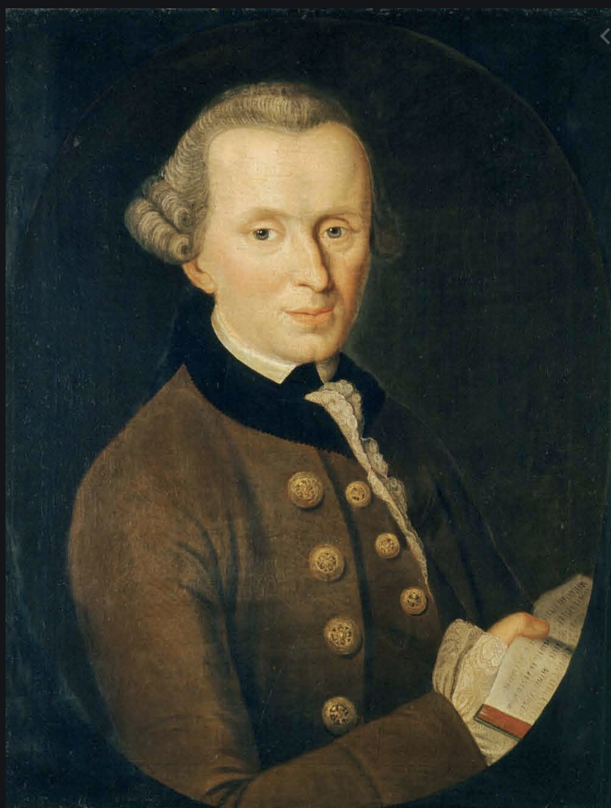
Kant – Categorical Imperative
Act only on that maxim by which you can at the same time will that it should become a universal law
So act as to treat humanity both in your own person and in the person of every other, always at the same time
Never simply as a means
(Johnson, 2016)

Slide 14
Deontological ethics -Rights
A right is a justified claim against another person’s behaviour.
So rights and duties are related in that the rights of one person imply the duty of someone else to uphold that right.
According to Kant we have a duty to treat every person as an end, and not as a means to our ends, because every person is autonomous and rational, and has intrinsic worth (SOAS, 2015)

Slide 15
The Universal Declaration of Human Rights
Article 18
“Everyone has the right to freedom of thought, conscience and religion; this right includes freedom to change his [sic] religion or belief, and freedom, either alone or in community with others and in public or private, to manifest his religion or belief in teaching, practice, worship and observance.
Article 19
“Everyone has the right to freedom of opinion and expression; this right includes freedom to hold opinions without interference and to seek, receive and impart information and ideas through any media and regardless of frontiers.”

Slide 16
Deontology
You are No Exception Principle (YANEP): "…in whatever you do, you should act for reasons that could serve as acceptable reasons for everyone."
Respect for Persons Principle (RPP): In all action one should respect others as sources of value and never merely as an instrument for one’s own purposes.
What makes a choice right is its conformity with a moral norm.
The Right is said to have priority over the Good (regardless how much ‘Good’ can be produced).
Ethics4EU (2020)

Slide 17
Critique of Deontological ethics
﻿Deontological ethical frameworks primarily focus on ethics in the intent behind action or the ‘rightness of an act’ rather than the outcomes of an act.
﻿But ethical intent is only part of the equation. It is also extremely important to consider the consequences of an action or designed process, whether the consequences (or outcomes) in question are intended or unintended.
(O’ Keefe and O’Brien)

Slide 18
Deontology
Is deontology possible? Does everyone agree on the right actions?

Slide 19
Consequentialist theories
Consequentialist theories are those that base moral judgements on the outcomes of a decision or an action. If the outcomes of an action are considered to be positive, or to give rise to benefits, then that action is held to be morally right.
Conversely, if the outcome causes harm, then the action is held to be morally wrong. The judgement of right or wrong depends on the consequences of the decision or action. The two main consequentialist theories considered here are egoism and utilitarianism.
(SOAS, 2015)

Slide 20
Utilitarianism
The modern form of the consequentialist theory of utilitarianism derives from 19th century British philosophers such as Jeremy Bentham and John Stuart Mill,
Rather than maximise individual welfare, utilitarianism focuses on collective welfare and it identifies goodness with the greatest amount of good for the greatest number of people: the ‘greatest happiness principle’.
So maximising benefits for the greatest number of people involves net assessments of benefit: utility is the net result of benefits and ‘disbenefits’ – or costs. Utility has entered modern economics as a key quantitative concept. The concept of trade-offs is specifically embraced and social and environmental cost–benefit analyses are explicit utilitarian tools for assessing the goodness of an action.
A simple balance sheet of costs and benefits can be drawn up to assess the overall utility of a decision.
(SOAS, 2015)

Slide 21
Critique of Utilitarianism
﻿if the outcomes of an action are what counts, a consequentialist framework would allow clearly unethical or immoral acts up to and including murder, if the benefit was great enough.
﻿Another problem with utilitarianism as an ethical framework is that the argument of ‘maximizing benefit and minimizing harm’ doesn’t necessarily mean that benefit and harm are evenly spread. What if the ‘maximized benefit’ benefits only a few?
(O’Keefe and O’Brien, 2018)

Slide 22
Consequentialist ethics vs Deontological ethics
Consequentialist ethics judge an action as right or wrong on the basis of the outcome of an action.
Deontological ethics hold that that action itself is right or wrong, regardless of the outcome.
(SOAS, 2015)

Slide 23
Egoism
Egoism is the theory that one’s self is, or should be, the motivation for all of our actions. In its strongest form, it argues that individuals only ever act in their own self-interest. Even where they appear to be acting in others’ interests, descriptive egoism explains that the person is really motivated by their own self-interest disguised by arguments (rationalisations) of ‘doing one’s duty’ or ‘helping others’.
In fact, our motivation behind doing ‘good deeds’ may be to make ourselves feel good; to make ourselves look good in the eyes of others; or because we believe that, by helping others, others will help us. Even if we donate money to charity anonymously, we may still only really do this because it makes us feel good about ourselves.
The theory of egoism is at the heart of capitalist arguments that a corporation’s sole responsibility is to its shareholders.
(SOAS, 2015)

Slide 24
Virtue Ethics
﻿In Western philosophy, the ancient Greek philosophers Plato and Aristotle are seen as the founders of virtue ethics.
﻿approaches ethics through the lens of self-improvement, virtues being desirable or ‘good’ character attributes.
(O'Keefe and O’Brien, 2018)

Slide 25
Virtue Ethics
﻿The aim of virtue ethics is to embody or live in harmony with the moral virtues valued by a culture or society.
An ethical person acts in a way that makes them a better person.
According to Aristotle, acting in accordance with virtue results in a well-lived life, ‘Eudaimonia’, or ‘happiness’.
(O'Keefe and O’Brien, 2018)

Slide 26
Virtue Ethics
Focus is on the development of moral character
An action is right insofar as it is the manifestation of a virtuous character trait, where virtuous character traits are those that are present in the fully flourishing human being.
A virtue is an excellent trait of character. It is a disposition, well entrenched in its possessor to notice, expect, value, feel, desire, choose, act, and react in certain characteristic ways.
Ethics4EU (2020)

Slide 27
Critique of Virtue Ethics
﻿One criticism of virtue ethics is that our values and understandings of ‘virtues’ are culturally bound.
Different cultures have different focuses on what they consider to be moral goods or virtuous conduct.
Which ‘virtues’ are valued over others may be different in different times, cultures and subcultures, so a focus on virtue ethics in a global context may need to engage with the relativist aspect of what is considered ‘virtuous’.
(O'Keefe and O’Brien, 2018)

Slide 28
Virtue Ethics
﻿These cultural differences obviously exist between different countries and ethnic cultures.
However, they can equally arise in the context of the cultural frame of an industry or social subculture.
For example, the virtue perspective of a technology-focused person might ﻿differ from that of a more human rights-focused individual.
(O'Keefe and O’Brien, 2018)

Slide 29
Which ethical theory?
Perhaps you believe that that individuals only ever act in their own self-interest (egoism)
You believe it sensible to to take a decision that has the best possible outcome for all concerned (utilitarianism).
Or you may believe that there are some universal rights which all humans have (deontology).
Or perhaps you do things each day because you think it makes you a good person and not because of any duty or consequences that this action might have (virtue ethics).
(SOAS, 2015)

Slide 30
Monism vs. Relativism
Some philosophers argue that it is possible to make objective decisions about our ethics and that identifying one, valid ethical theory should be the main task of philosophers. This position is called ethical monism.
Others philosophers, in contrast, believe that it is impossible to make such objective ethical judgements and that any decision about which particular ethical approach is ‘right’ is nothing more than a personal preference, and will depend on people’s individual feelings, their cultural and religious background, etc. This position is called ethical relativism.
(SOAS, 2015)

Slide 31
Ethical Pluralism
Ethical pluralism is the acceptance that there may be more than one correct moral framework that we can use. However, it differs from relativism in that it does not accept that all frameworks are equal – morality, according to a pluralist, does not simply come down to personal preference. It is possible to make rational judgements between various frameworks and to judge some to be better than others.
(SOAS, 2015)

Slide 32
Current Ethics
Generally, in Western countries, at least, there are trends away from absolutism and towards flexibility and subjectivity, perhaps towards a more modern – or post-modern – personalised, individualist, and situational ethics.
Alternative cultural paradigms are likely to contribute new insights that may not replace the evolutionary pathway of philosophy started by the ancient Greeks around 2500 years ago, but are likely to influence the patterns of behaviour within international institutions, organisations, and business throughout this century.”
(SOAS, 2015)

Slide 33
Principle Ethics
Instead of being a hard line deontologist or consequentialist, an option is to avoid absolutism and recognize that there are several ethical principles to consider and balance.
Example principles:
(1) Beneficence – promoting the welfare of others
(2) Nonmaleficence – avoiding actions that cause harm and preventing harm
(3) Autonomy – fostering the right of others to make decisions on their own behalf
(4) Justice –distributing benefits and burden equally;
(5) Fidelity – honoring commitments and keeping promises, both stated and
implied;
(6) Veracity – being honest and telling the truth.
https://www.mccormick.northwestern.edu/research/engineering-education-research-center/
documents/events/insight-xiii/ethics-frameworks-and-philosophies-edit.pdf

Slide 34
Beyond Europe
Western academia tends to follow European traditions. Researchers and philosophers have identified this as limiting when trying to consider ‘universal’ ethical principles to guide technological development and AI, and other sociotechnical systems that are deployed globally and will interact with different ‘ethics of society’ and different social and cultural contexts.
European philosophical traditions tent to emphasize rationalism, assumptions of fixed conceptual dichotomies such as ‘good’ and ‘bad’, ‘emotion’ versus ‘reason’, or ‘ethical’ versus ‘scientific’ (O’Keefe and O’Brien, 2023)

Slide 35
Non Western Philosophy
Ubuntu - ubuntu ethics (Africa) is defined as a set of values central among which are reciprocity, common good, peaceful relations, emphasis on human dignity, and the value of human life as well as consensus, tolerance, and mutual respect.
https://www.bbc.com/reel/video/p0bqvs1f/the-philosophy-that-can-change-how-you-look-at-life

Slide 36
Non Western philosophy
Māori ethics - An example of philosophical world views that are not well described by fixed dichotomous binary ‘good/bad’ classifications are various Māori traditions and values. Māori ethical values and practices, as understood to have developed pre-European contact, are described in terms of the sacredness of an interconnected world in which understanding your kinship, following the example of the ancestors, connection and being in accord with the nature of things are ways to guide right action.

Slide 37
So what does this have to do with technology?
Watch this video on ethics and the design of autonomous systems
https://www.ted.com/talks/eleanor_nelsen_would_you_sacrifice_one_person_to_save_five?language=en

Slide 38
Questions
Had you heard of “the trolley problem before”?
Is it even possible to encode these types of ethical decisions into autonomous systems?
In the examples of autonomous vehicles or military drones who do you think should make these ethical decisions in the design of these systems?

Slide 39
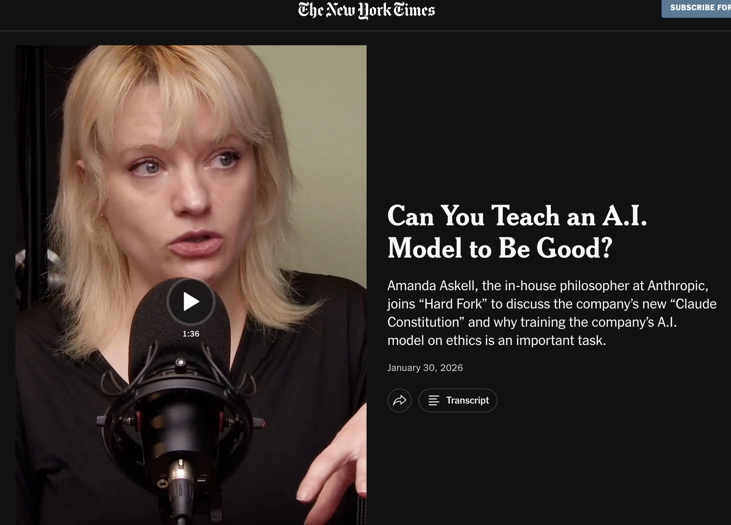
Anthropic’ Claude Case Study
https://www.youtube.com/watch?v=HDfr8PvfoOw

Slide 40
References
O’Keefe, K. and O’Brien, D. (2018) Ethical Data and Information Management: Concepts, Tools and Methods (1st. ed.). Kogan Page Ltd., GBR.
O’Keefe, K. and O’Brien, D. (2023) Data Ethics : Practical Strategies for Implementing Ethical Information Management and Governance. Kogan Page Ltd., GBR
Ethics4EU (2020) Foundational Ethics in Computing Brick.
﻿Hasselbach, G and Tranberg, P (2017) Data Ethics: The new competitive advantage, PubliShare, Copenhagen.
SOAS (2015) Ethics for Environment and Development; Unit One: Introduction to Ethics. Available: https://www.soas.ac.uk/cedep-demos/000_P563_EED_K3736-Demo/module/pdfs/p563_unit_01.pdf
Johnson, R., (2016) Kant’s Moral Philosophy”, The Stanford Encyclopedia of Philosophy. Available: https://plato.stanford.edu/entries/kant-moral/

